Slide 1
Non Fungible Tokens
Dr. S. Qaiser Ali Shah

Slide 2
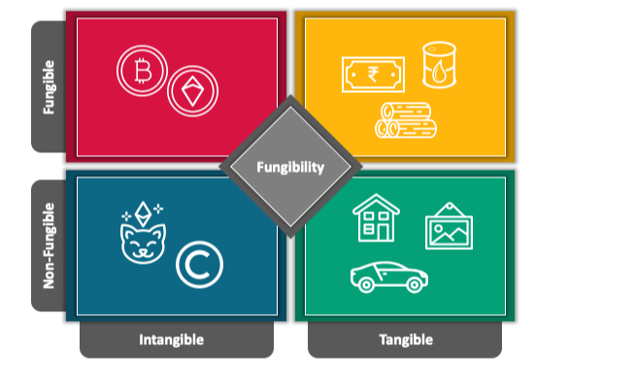
Types of Assets

Slide 3
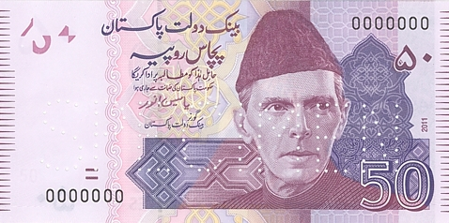
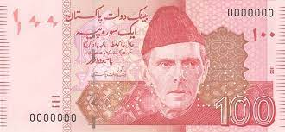
Fungible Tokens
Fungible that is replaceable

Slide 4
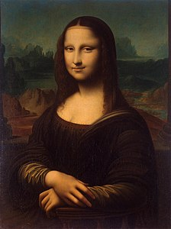

Non-Fungible Token
Non-Fungible
Unique
Non exchangeable or non replaceable
Token:
Proof of Ownership in digital form

Slide 5
Key Characteristics of NFTs
Indivisibility
Uniqueness
Ownership
Rarity
Transparency
Interoperability

Slide 6
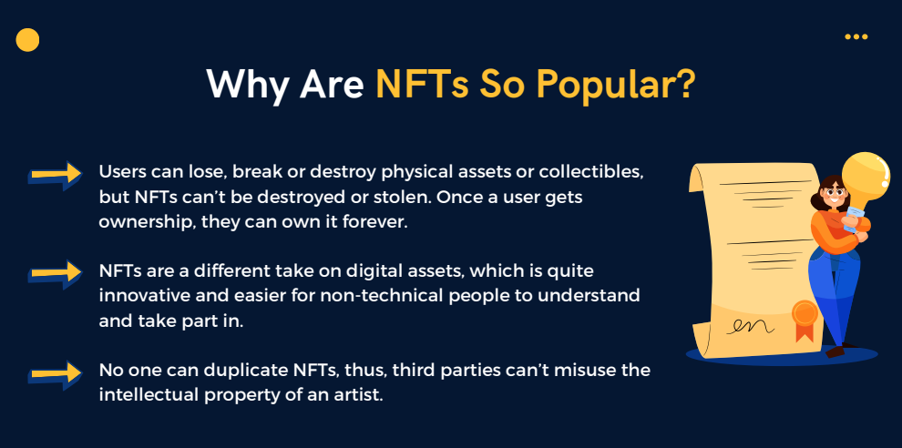

Slide 7
Can anyone create NFTs?
Technically yes but not all have high price
users need to have a reputation within the community to earn a good value for their work
A higher social media presence and a fan base are the highest factors in determining an NFTs value

Slide 8
Safety of NFTs
The security level of NFTs is similar to any type of digital asset and very close to cryptocurrencies.
All of the NFTs are stored on the blockchain platform where the ledger is immutable, making it impossible to delete or alter the ownership.
Blockchain offers robust security protocols and eliminates the scope of cyber-attacks.

Slide 9
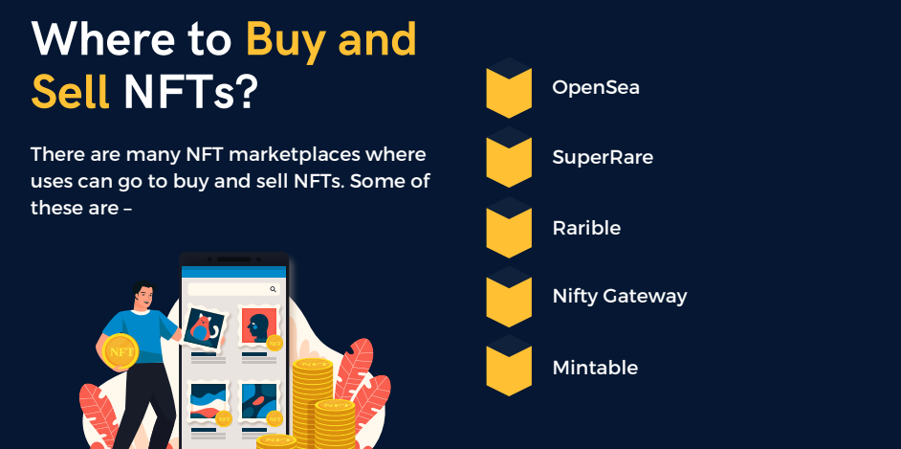

Slide 10
Popular NFT Projects
CryptoPunks: Collection of digital art collectibles. Unique character with a similar art style (24x24 pixels).
Axie Infinity: Axie Infinity is a type of game where players collect Axies and use these to battle, breed, raise other Axies.
Decentraland: Decentraland is a virtual world where certain items within the world are NFTs. It uses the Ethereum blockchain.

Slide 11
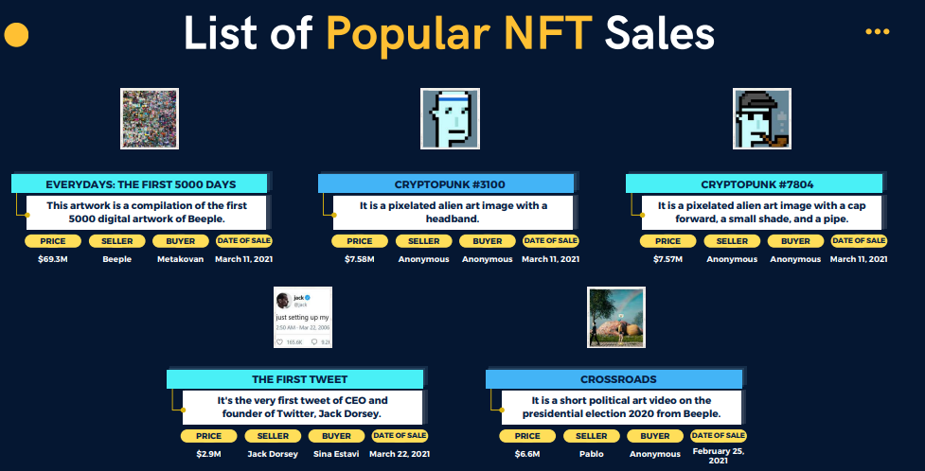

Slide 12
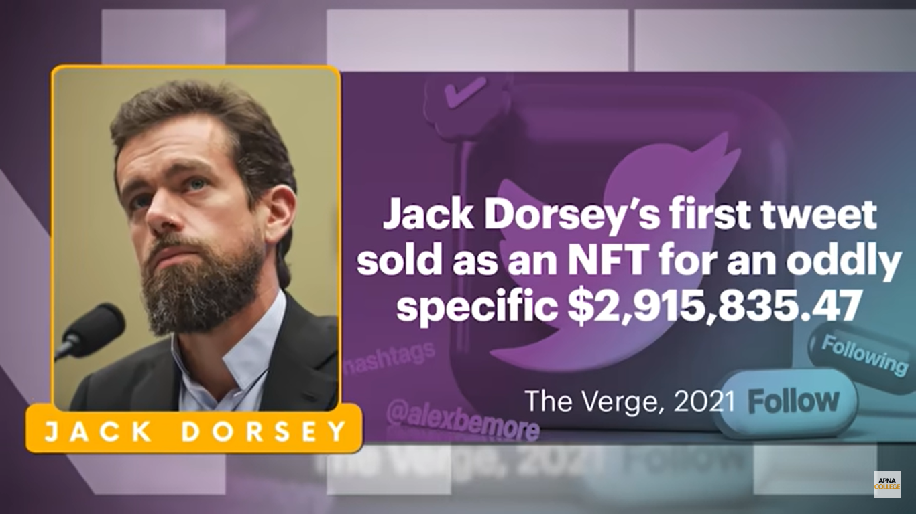
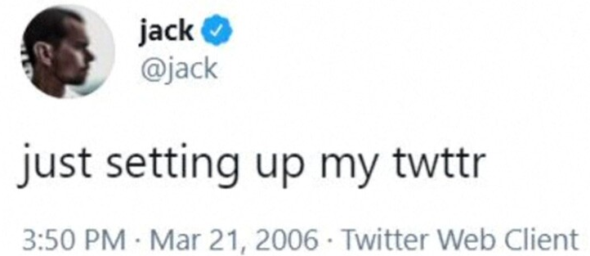

Slide 13
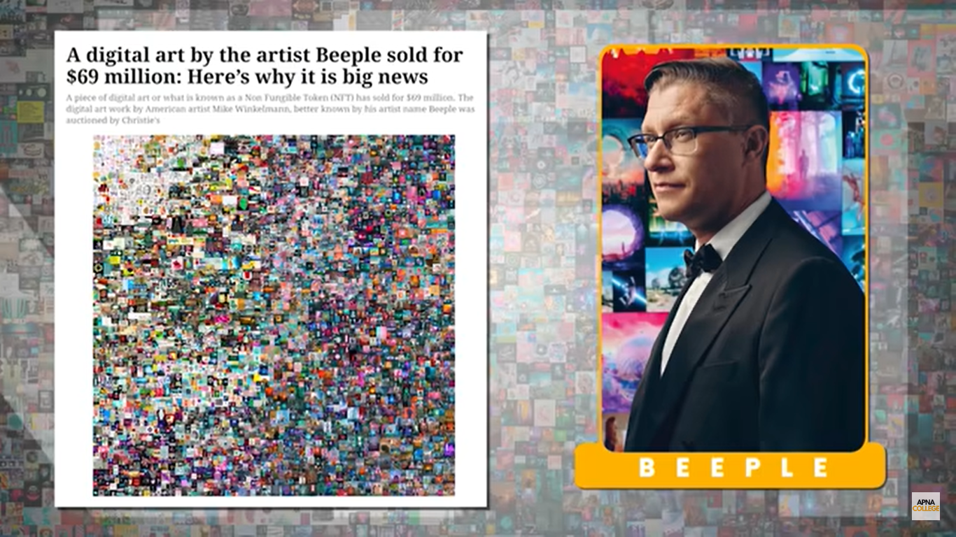

Slide 14
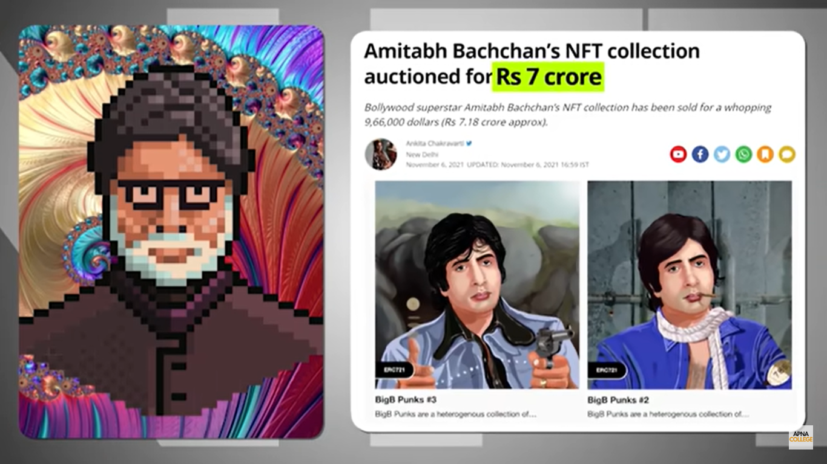

Slide 15
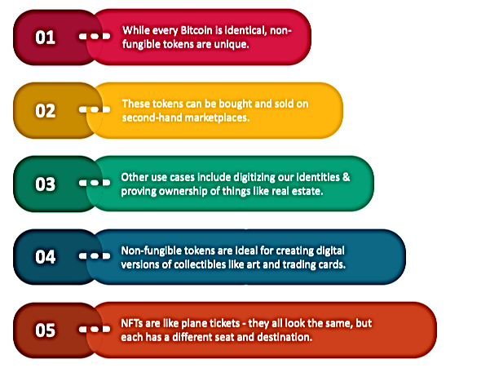
Summary

Slide 16
Thank You

